Slide 1
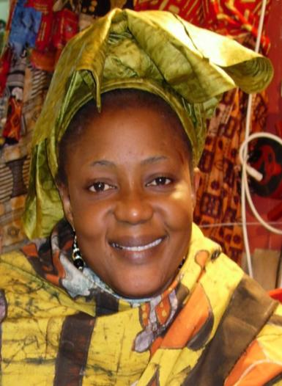

5-1 Let’s Practice
_______________?
What time
is it
It´s 1:30

Slide 2
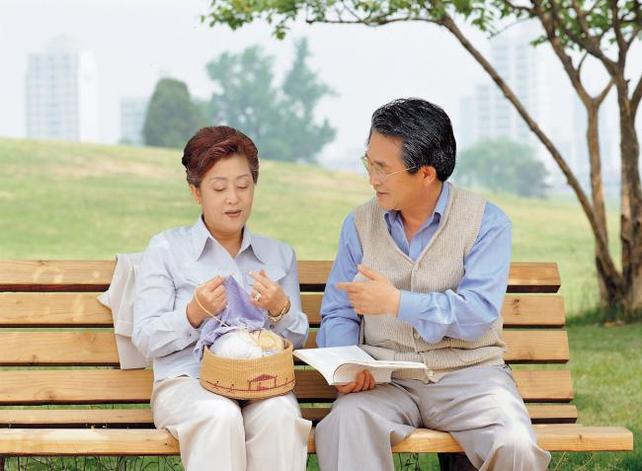
5-1 Let’s Practice
What’s the date today
___________________?
The 3rd of May, 2012.
May 2012
Sun | Mon | Tue | Wed | Thu | Fri | Sat
 |  |  |  | 1 | 2 | 3
4 | 5 | 6 | 7 | 8 | 9 | 10
11 | 12 | 13 | 14 | 15 | 16 | 17
18 | 19 | 20 | 21 | 22 | 23 | 24
25 | 26 | 27 | 28 | 29 | 30 | 31

Slide 3
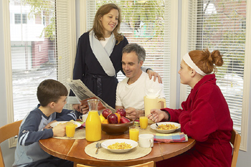
5-2 PREPOSITIONS OF TIME
We eat breakfast
in the morning.

Slide 4
5-2 PREPOSITIONS OF TIME
at
(a) We get up at 5:00 A.M.
(b) We exercise at 2:00 P.M.
at + specific time

Slide 5
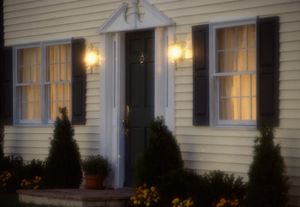
5-2 PREPOSITIONS OF TIME
at
(c) I get home at night.
at + night

Slide 6
5-2 PREPOSITIONS OF TIME
in
(d) School starts in September.
(e) She went to Florida in 2005.
(f) I take a walk in the morning.
in + the morning
in + month
in + year

Slide 7
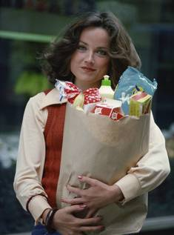
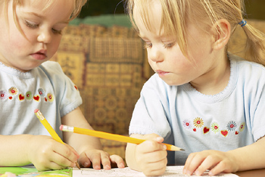
5-2 PREPOSITIONS OF TIME
on
(i) She goes shopping on Tuesday.
(j) The twins were born on
March 3, 2005.
on + specific date
on + specific day

Slide 8
5-2 PREPOSITIONS OF TIME
From ... to
(k) I work from 9:00 to 5:00.
from (a time) to (a time)

Slide 9
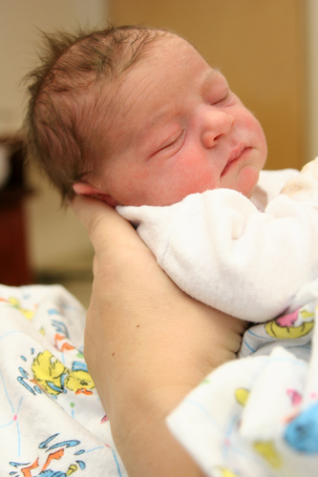
5-2 Let’s Practice
at in on from ... to
on
The baby was born __ Monday.
The baby was born __ July.
in
at
The baby was born __ 2:00 A.M.

Slide 10
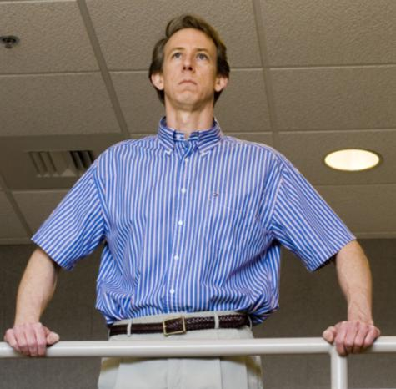
5-2 Let’s Practice
at in on from ... to
from
I work ____ 8:30 A.M.
__ 4:30 P.M.
to

Slide 11
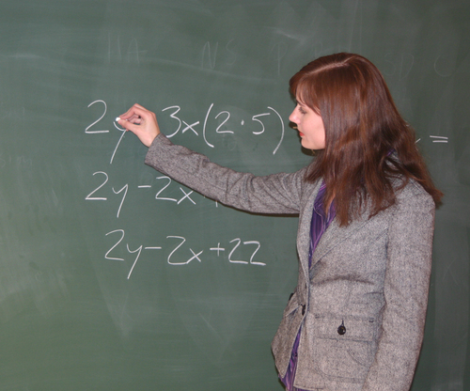
5-2 Let’s Practice
at in on from ... to
I teach a class __ 8:30 A.M. __ Monday.
at
on

Slide 12
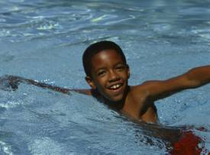
5-2 Let’s Practice
at in on from ... to
He swims __ the afternoon.
in

